Slide 1
TRAVEL PORTFOLIO
STUDENT NAME
REGISTER NO NMIS
DEPARTMENT
COLLEGE
UNIVERSITY
:
:
:
:
:
RESHMI J
F035990B6398FC7AE9A4941558146FC9
B.Sc CS
C.S.I Ewart women's Christian college
Madras University

Slide 2
PROJECT TITLE
Travel portfolio using Frontend web development

Slide 3


AGENDA
Problem Statement
Project Overview
End Users
Tools and Technologies
Portfolio design and Layout
Features and Functionality
Results and Screenshots
Conclusion
Github Link
3/21/2024 Annual Review

Slide 4

PROBLEM STATEMENT
In today’s fast-paced digital era, people have limited opportunities to truly explore and learn about the world around them. Although information is widely available, it is often scattered, unorganized, or overwhelming. Many individuals—students, travelers, researchers, or general knowledge seekers—struggle to find a reliable and engaging platform that allows them to discover new countries, culturals, places and facts in an interactive way.

Slide 5

PROJECT OVERVIEW
"Explore the World" is a platform that helps people learn about countries, cultures, places, and facts in an easy and interactive way, allowing users to virtually travel and gain global knowledge.
My portfolio contains (About me, Travel gallery, Skills, Hobbies, contact).
Main idea: Showcase my personal achievements, Travel gallery, skills.

Slide 6

WHO ARE THE END USERS?
.
.
.
.
.
(for insipiration and save memory)
Photographers
Writes
Researchers
Toursists
Learners
(for wrote creative stories)
(to spread knowledge for different cultures)
(to visit new places and enjoy adventures)
(for education, history, cultural studies)

Slide 7

TOOLS AND TECHNIQUES
→⁠
HTML
CSS
JAVASCRIPT
→⁠
Structure (pages, sections)
*
*
*
→⁠
Styling (layout, colors)
Interactivity (navigation menu, animation, form validation )
.
Code editor (CODEPEN) and hosting platform (EXPORT ZIP)

Slide 8
POTFOLIO DESIGN AND LAYOUT
Sections included:
Home / About me
Travel gallery
Skills
Hobbies
contact
Responsive layout (Mobile + Desktop view)
°
°
°
°
°
°
°
8

Slide 9
FEATURES AND FUNCTIONALITY
.
.
.
.
.
Navigation bar with smooth scrolling.
Project showcase with images/details.
Interactive elements (hover effects, animations).
Contact form (with validation).
Responsive design for all devices.

Slide 10
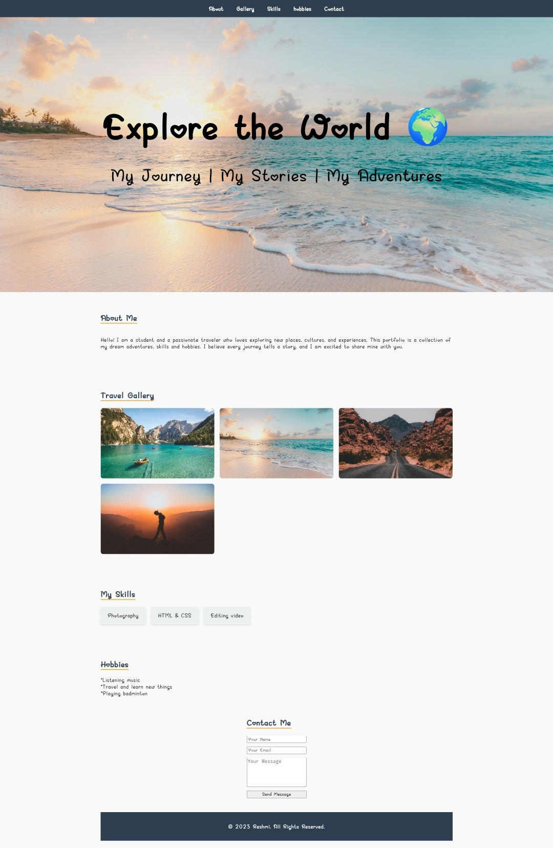

RESULTS AND SCREENSHOTS
3/21/2024 Annual Review
10

Slide 11
CONCLUSION
Highlights
final summary
Benefits to society
:
Adventure activities, Memorable experience, Learning opportunities, personal growth, improving knowledge.
:
"Explore the world to discover new cultures, breathtaking places, and unforgettable experiences."
:
Culture exchange, Environmental awareness, Economic growth, Global knowledge sharing.
11

